Slide 1
Understanding RFID Blocking
Protecting Your Sensitive Information from Unauthorized Scanning
Presented by: Saif Ullah

Slide 2
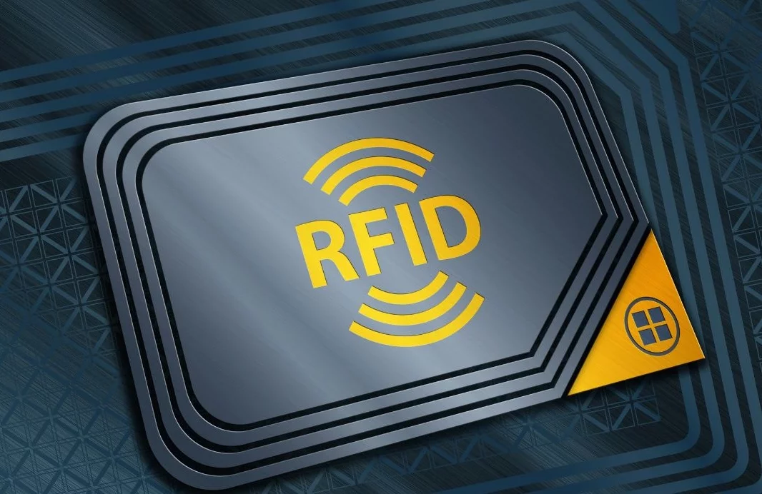
RFID

Slide 3
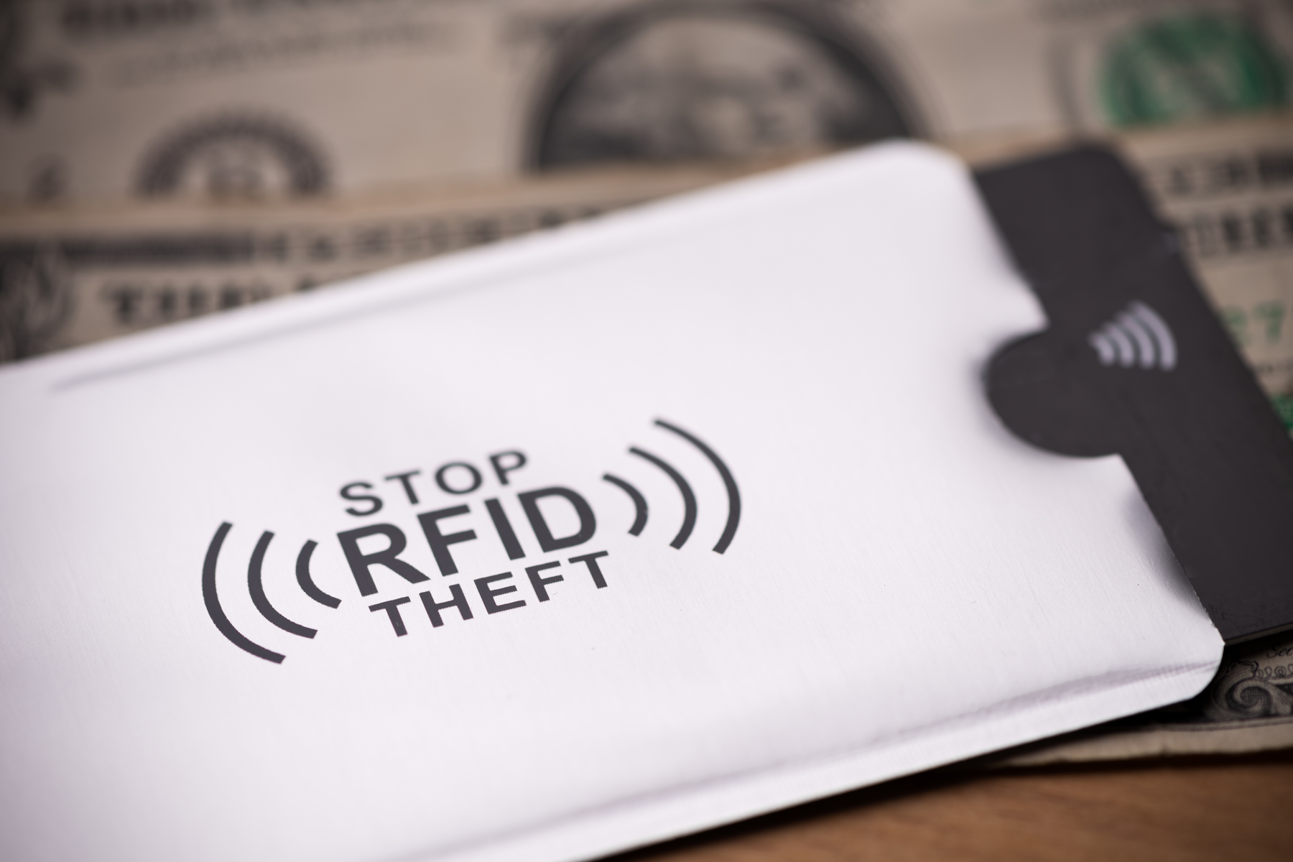
RFID Blocking

Slide 4
Table of contents
Introduction
How RFID Works
Where RFID Chips Are Used
Risks of RFID Technology
RFID Blocking Solutions
Best Practices for RFID Protection

Slide 5
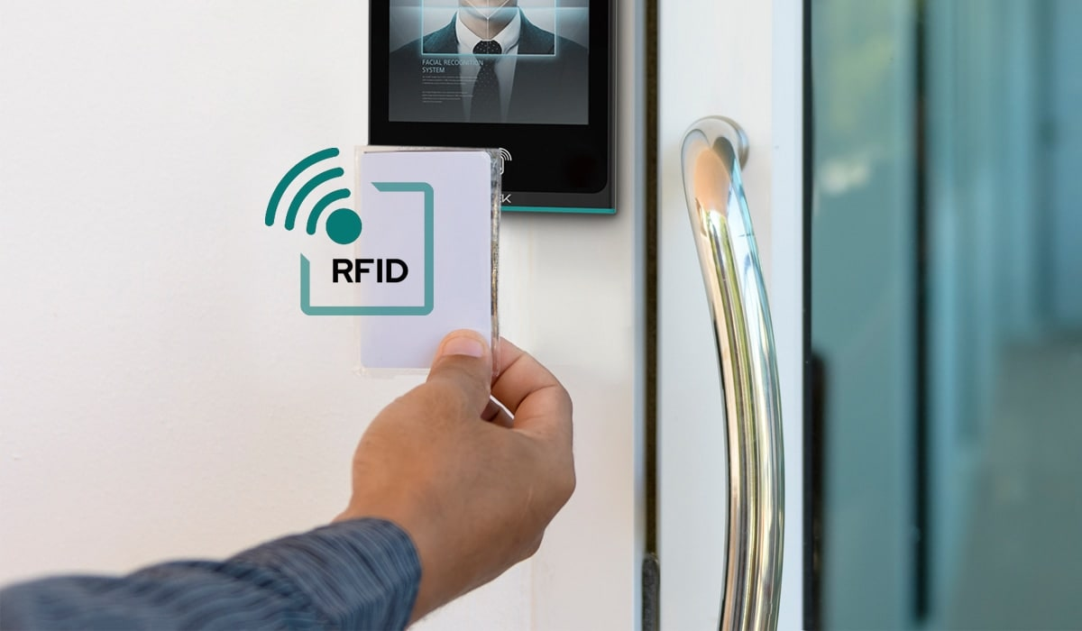
Introduction
What is RFID?
RFID stands for Radio-Frequency Identification.
It uses radio waves to transfer data wirelessly between a tag and a reader.
Common Uses of RFID:
Contactless payment cards
E-passports
Public transport smart cards
Employee ID badges

Slide 6
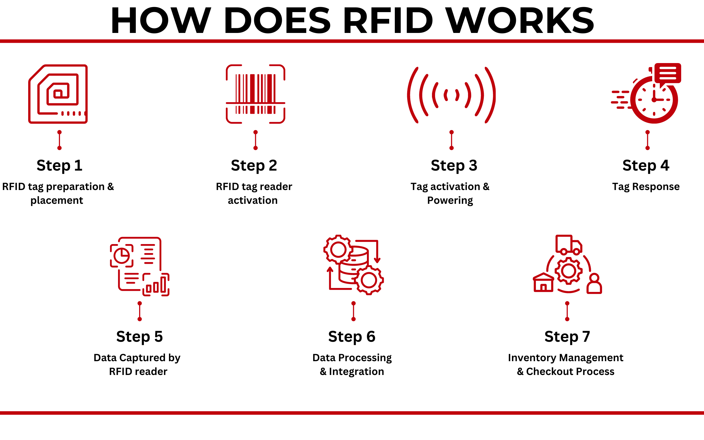
How RFID Works
Components of RFID: RFID tag and reader interact through radio signals.
How Data Transfers: Reader sends signals; tag responds with stored data.
Example: Tap-and-pay credit card transactions.

Slide 7
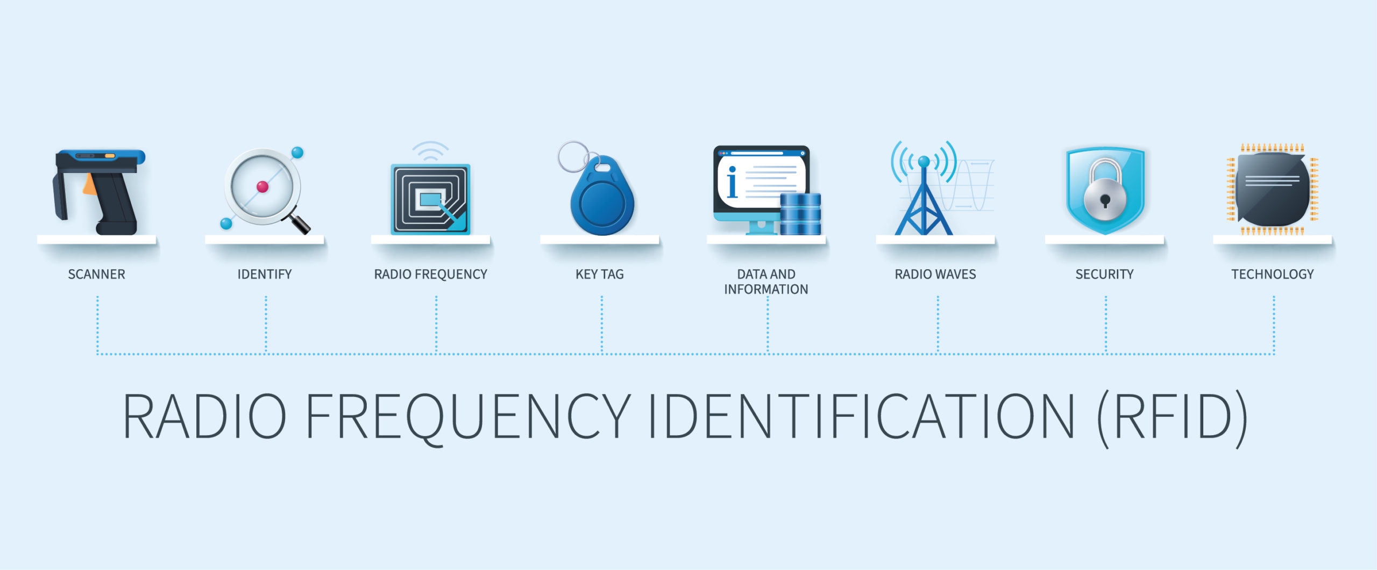
Where RFID Chips Are Used
Examples: Found in credit cards, passports, travel cards, and employee badges.

Slide 8
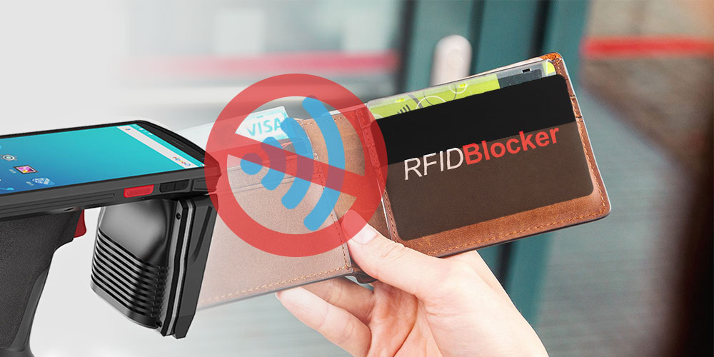
Risks of RFID Technology
Unauthorized Scanning: Hackers use scanners to steal sensitive information.
Data Skimming: Extracting card data to make illegal transactions.
Real-World Cases: RFID scams in crowded areas and airport hacking incidents

Slide 9
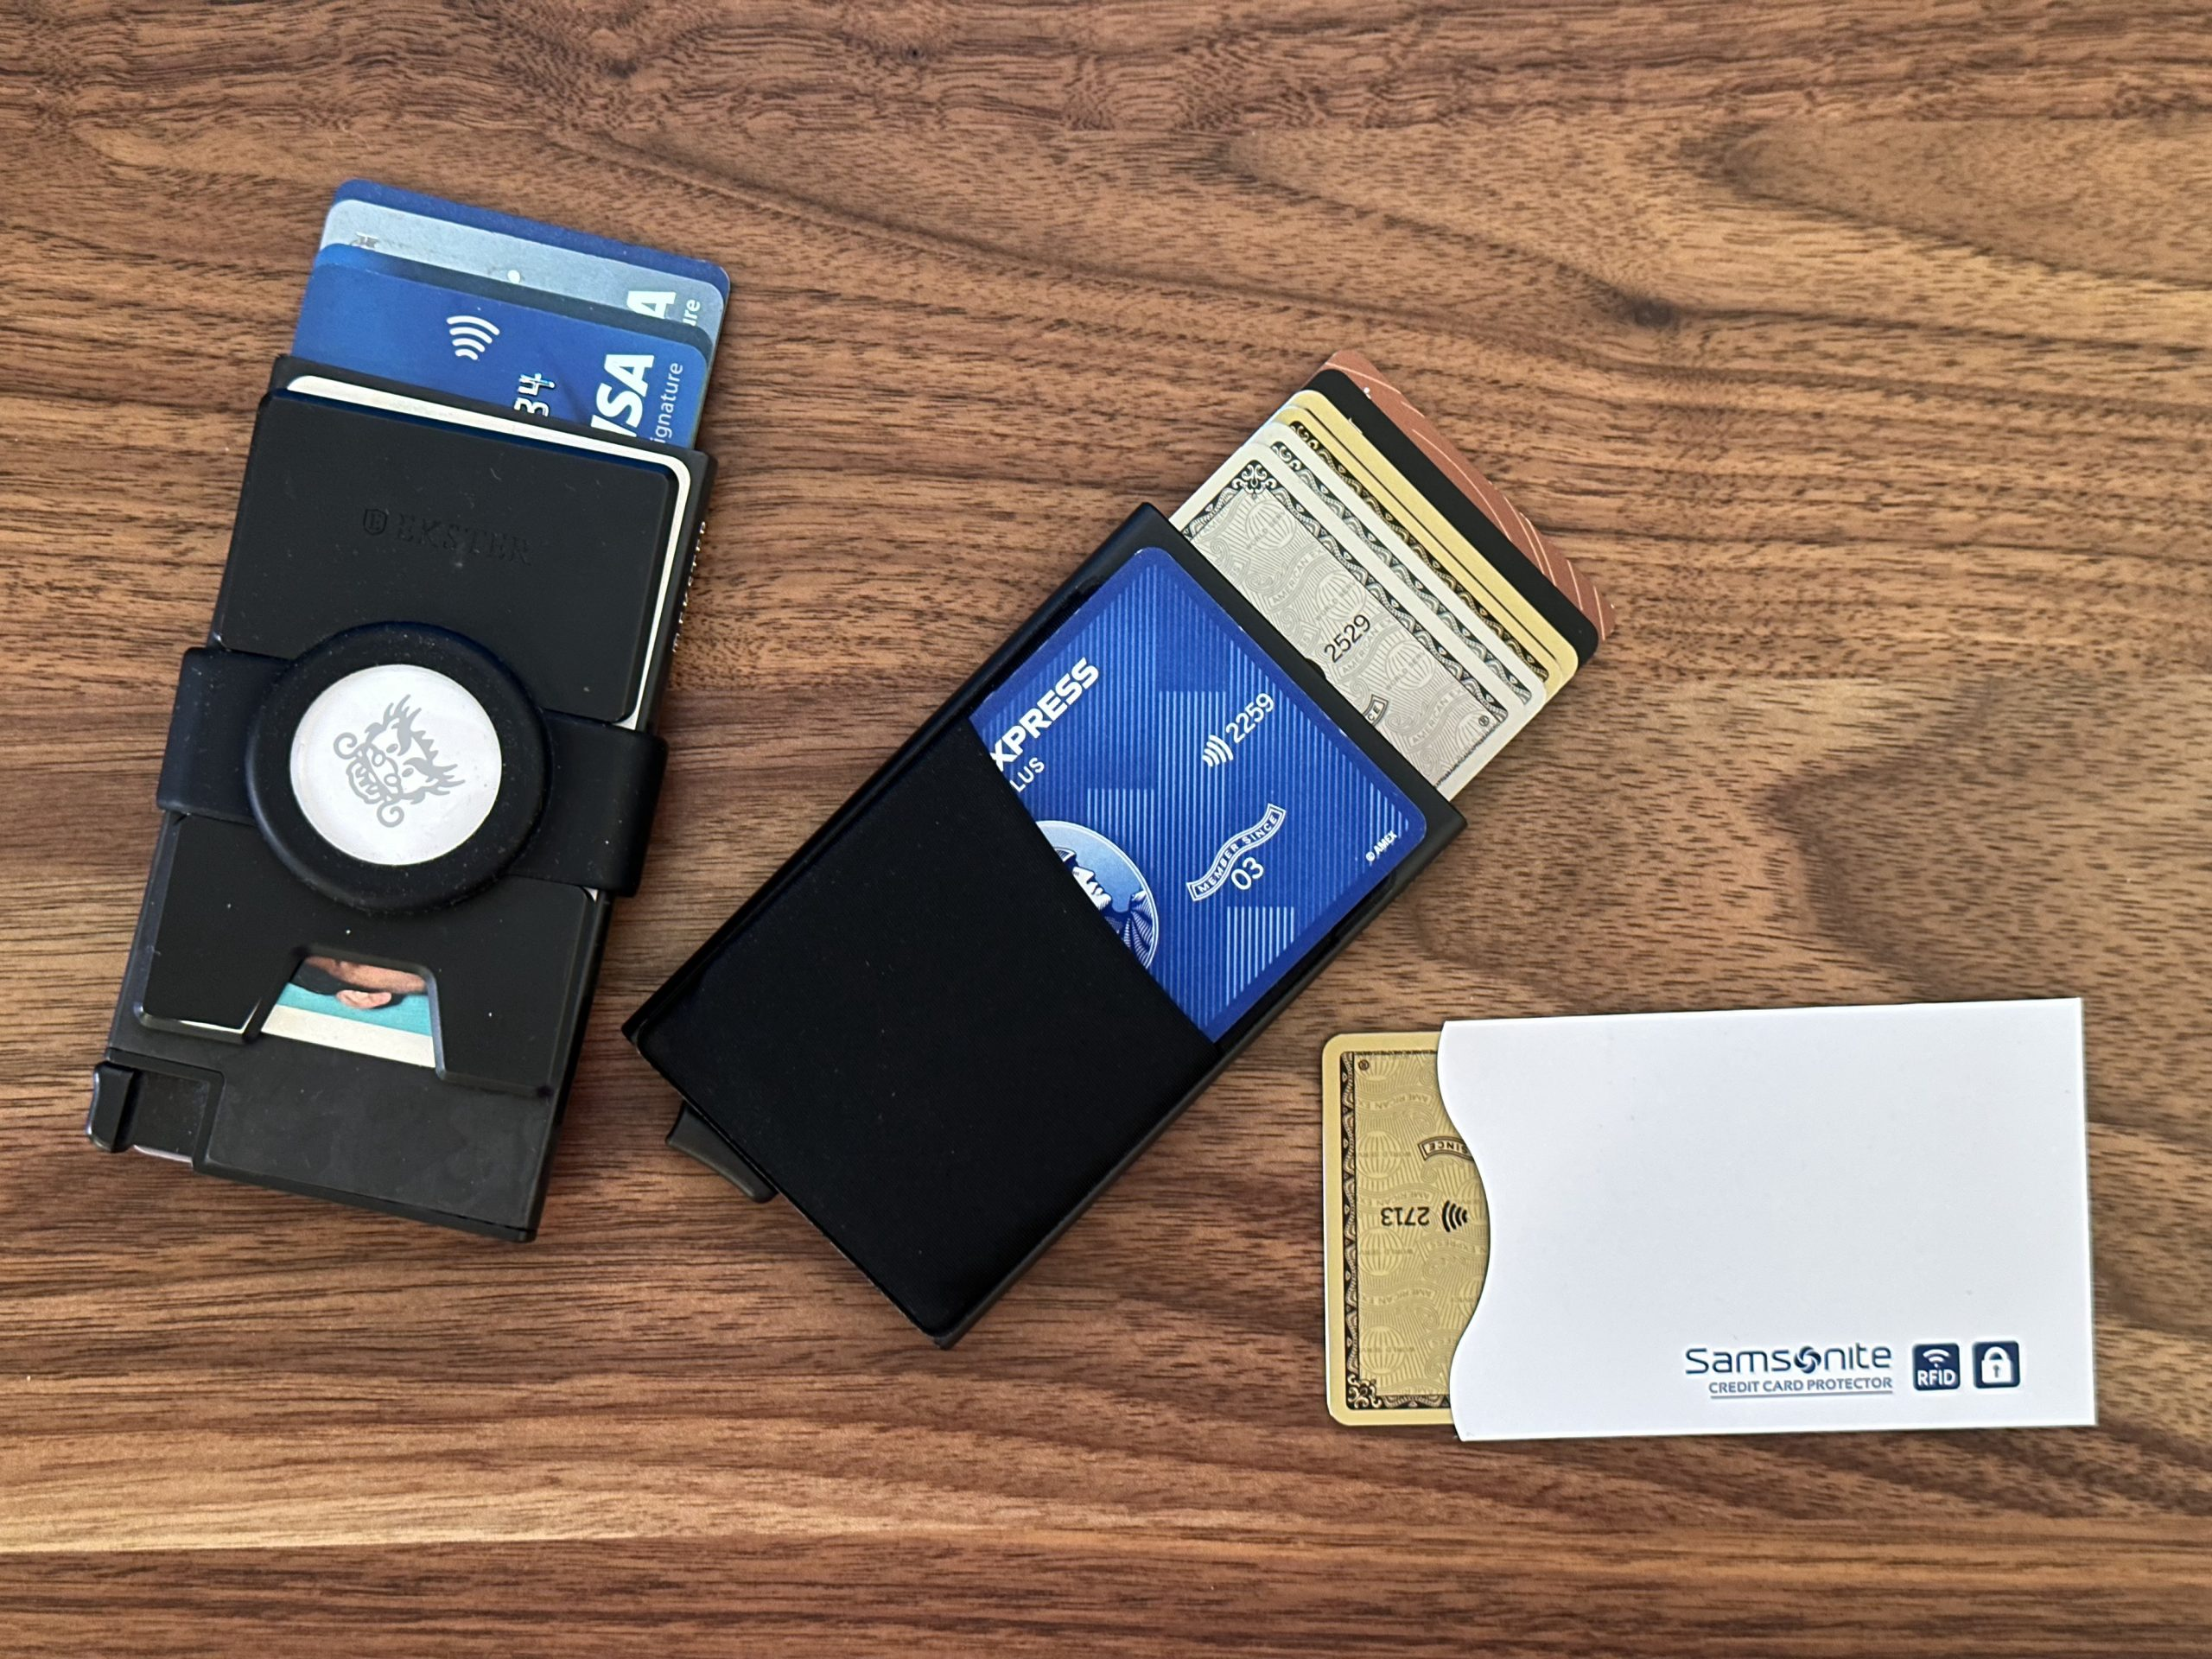
RFID Blocking Solutions

Slide 10
RFID Blocking Solutions
How It Works: Blocks radio signals to prevent unauthorized access.
Popular Solutions:
RFID Wallets: Built with blocking materials like metal layers.
RFID Sleeves: Protect individual cards effectively.
DIY Methods: Wrapping cards in aluminum foil.

Slide 11
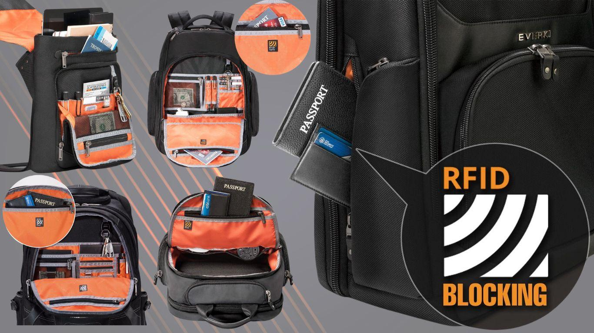
Best Practices for RFID Protection

Slide 12
Best Practices for RFID Protection
Use wallets or sleeves with RFID blocking.
Limit carrying RFID-enabled cards unnecessarily.
Regularly check bank and credit card statements.
Report unauthorized activities quickly.

Slide 13


